Slide 1
OFHA 2024 Town Hall
February 12, 2024

Slide 2
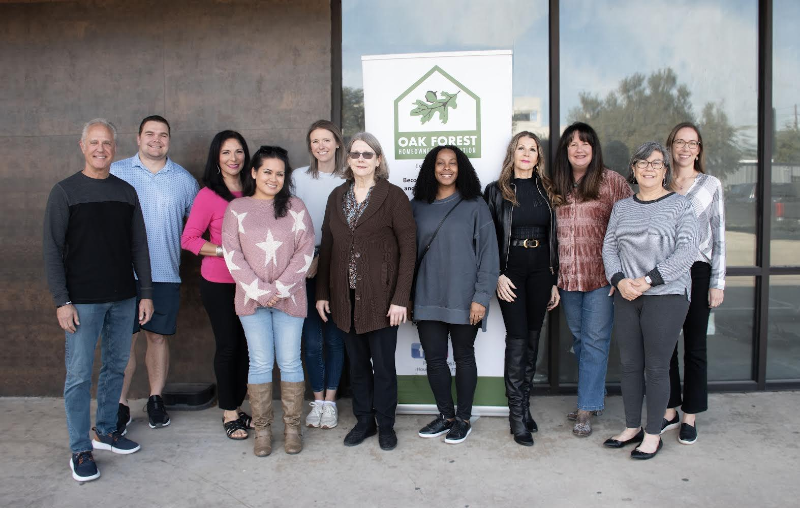
MEET THE 2024 BOARD
Team picture
Lucy Fisher Fraga Cain
President
Stacey Venamon
First Vice President
Nancy Ann Gonzalez
Second Vice President
Carrie Austin
Secretary
Phil Reiser
Treasurer
Kim Folger
Co-Director Neighborhood Patrol
Frances Fuhr
Co-Director Neighborhood Patrol
Deena Alcorta
Director of Public Relations
Danielle Maudlin
Beautification Co-Chair
Mary Jane Simon
Beautification Co-Chair
Mary Wenzel
Parliamentarian
Mark Thomas
Sergeant at Arms
Vacant
Director Community Relations

Slide 3
About Oak Forest Homeowners Association (“OFHA”)
Established in 1947, Oak Forest contains approximately
5,526 homes in 18 sections
OFHA is a voluntary HOA, led by a group of dedicated volunteers
HOA focus areas include community participation, beautification, security, and ongoing deed restriction enforcement
Currently only 13% of households in Oak Forest
participate in some capacity

Slide 5
THANK YOU, OFHA BUSINESS MEMBERS!

Slide 7
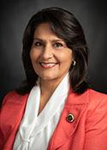
Guest Speaker
Penny Morales Shaw
Texas State Representative
District 148

Slide 8
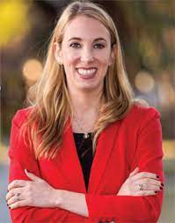
Guest Speaker
Abbie Kamin
Houston City Council District C

Slide 9
Houston Police Department Know Your Community!
Speaker: Officer Christopher Cabrera
Houston Police Department
HPD Non-Emergency Line: 713-844-3131
HPD North Command Station
9455 W. Montgomery
832-394-3800

Slide 10
Safety & Security Speaker Know Your Community!
Erica Rocha, SEAL Manager
Neighborhood Patrol
Security Hotline:
832-900-7017
Please report all incidents to
S.E.A.L and Houston Police Department
Email security@ofha.org
x

Slide 11
Committee Report - Security
2024 Focus Areas: Awareness & Participation
AWARENESS
Existence
Program Benefits
Visibility of Campaign
Participation
12% of Households (~640)
Align with Businesses Investing in Community
Sponsor a Neighbor

Slide 12
Oak Forest Post Office Update
Quonshella Leblanc-Ford
Oak Forest Post Office Manager

Slide 13
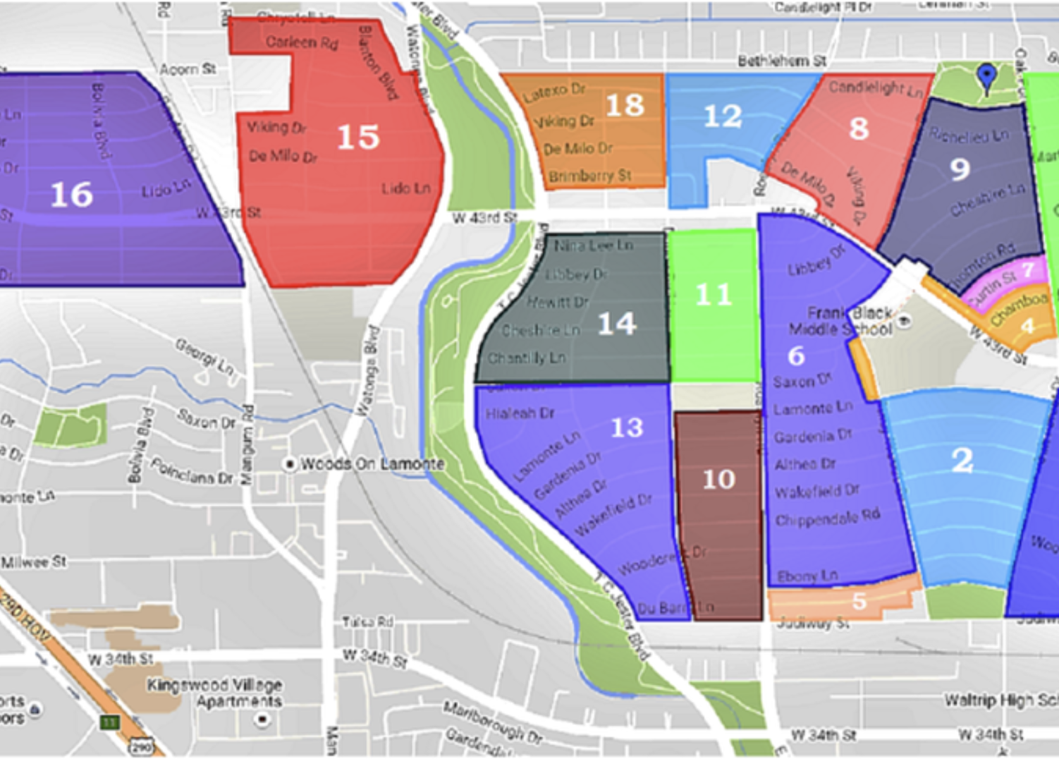
Deed Restrictions Know Your Community!
Speakers:
Mitchell Katine, OFHA Attorney
Stacey Venamon, OFHA Deed Restriction Committee Chair
planreview@ofha.org
Committee review of new construction plans for homes, pools, outdoor kitchens, etc.
Report possible violations
Schematic planning

Slide 14
Committee Report - Finance
Speakers:
Rosa Prudencio, OFHA CPA Manager
Phil Reiser, OFHA Treasurer

Slide 15
Committee Report - Beautification
Speakers:
Danielle Maudlin, OFHA Beautification Co-Chair
Mary Jane Simon, OFHA Beautification Co-Chair

Slide 16
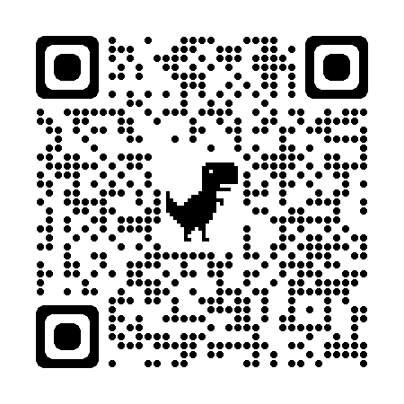
2024 Community Meetings
Speaker:
Deena Alcorta,
Director of Public Relations
OFHA Monthly Meetings
Board Meetings – 2nd Monday of the Month @ 6pm
Community Meetings – 2nd Monday of the Month @ 7pm
Location: Candlelight Community Center,
1520 Candlelight Lane

Slide 17
2024 Community Events
OFHA Fundraisers
Feb. 17 – Mardi Gras Pub Crawl
April 23 – Uncorked Wine Tasting
Oct 5 – Tour de Oak Forest
Oct 11 to 20 – Taste of Oak Forest Restaurant Week
Dec 8 – Ugly Sweater Holiday Party
CALENDAR OF EVENTS QR CODE

Slide 18
2024 Community Events
Other Events
Saturday Mornings - OFHA & FIT Run/Walk
Quarterly Committee Meetings
Summer - Family Movie Nights
National Night Out – Tuesday, October 1, 2024

Slide 19
UPCOMING EVENTS

Slide 20
2024 Tour de Oak Forest

Slide 21
2024 Restaurant Week
October

Slide 22
2024 NEW RESIDENTS MEET UP

Slide 23
HOW TO REACH US
www.OFHA.org
CALENDAR OF EVENTS: publicrelations@ofha.org
DEED RESTRICTIONS: planreview@ofha.org
MEMBERSHIP/GENERAL QUESTIONS: info@ofha.org
NEIGHBORHOOD PATROL: security@ofha.org

Slide 24
OFHA 2024 Focus Areas
PARTICIPATION
COMMUNITY
NEIGHBORHOOD
HOA Awareness
Community Patrol Program
Beautification
Community Events
Deed Restriction
Community “Pillar” Improvements
Notes:
Note: Community Pillar refers to Post office & other key pillars that need fixing up

Slide 25
Connect With Us!
WEBSITE
SOCIAL MEDIA
www.OFHA.org
www.Facebook.com/OFHAboard
@OakForestHOAHoustonTX
EMAIL
info@OFHA.org

