Slide 3
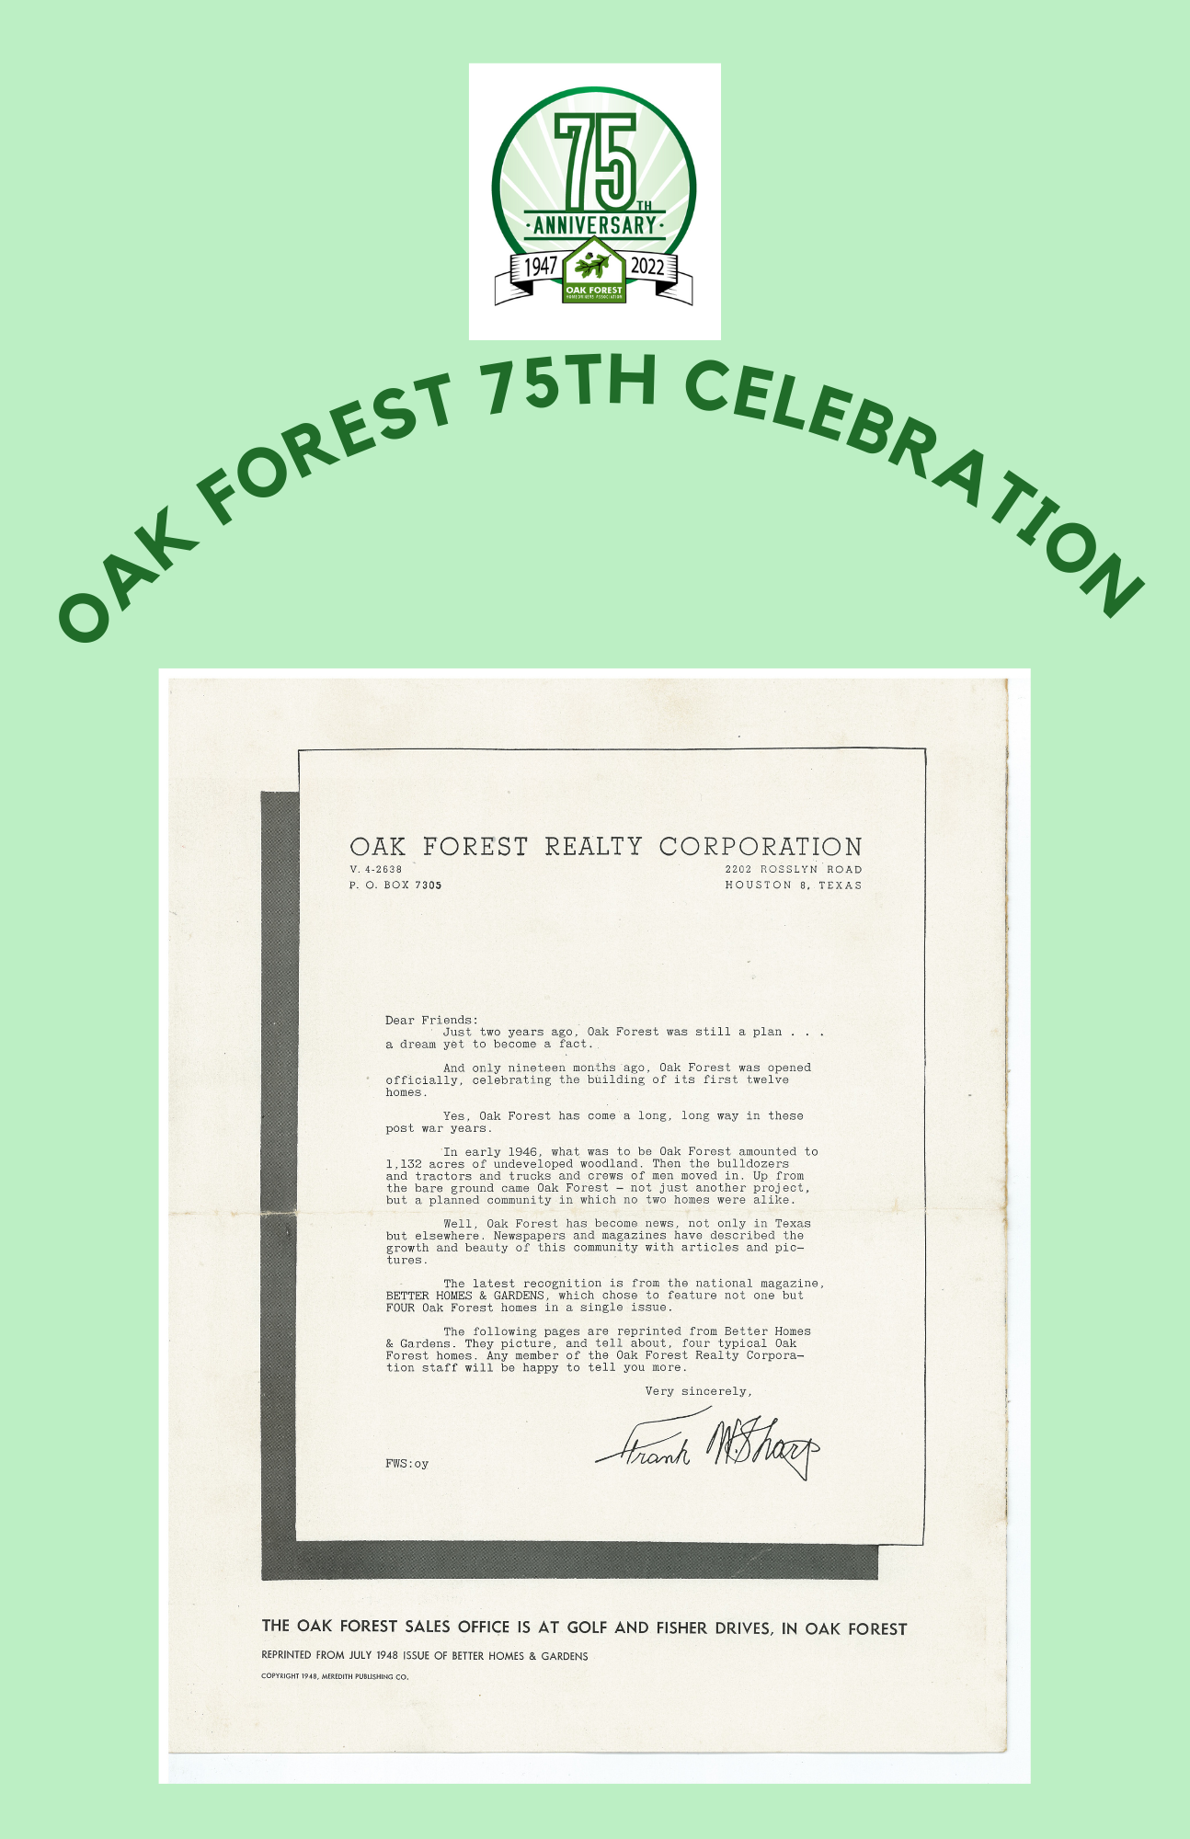
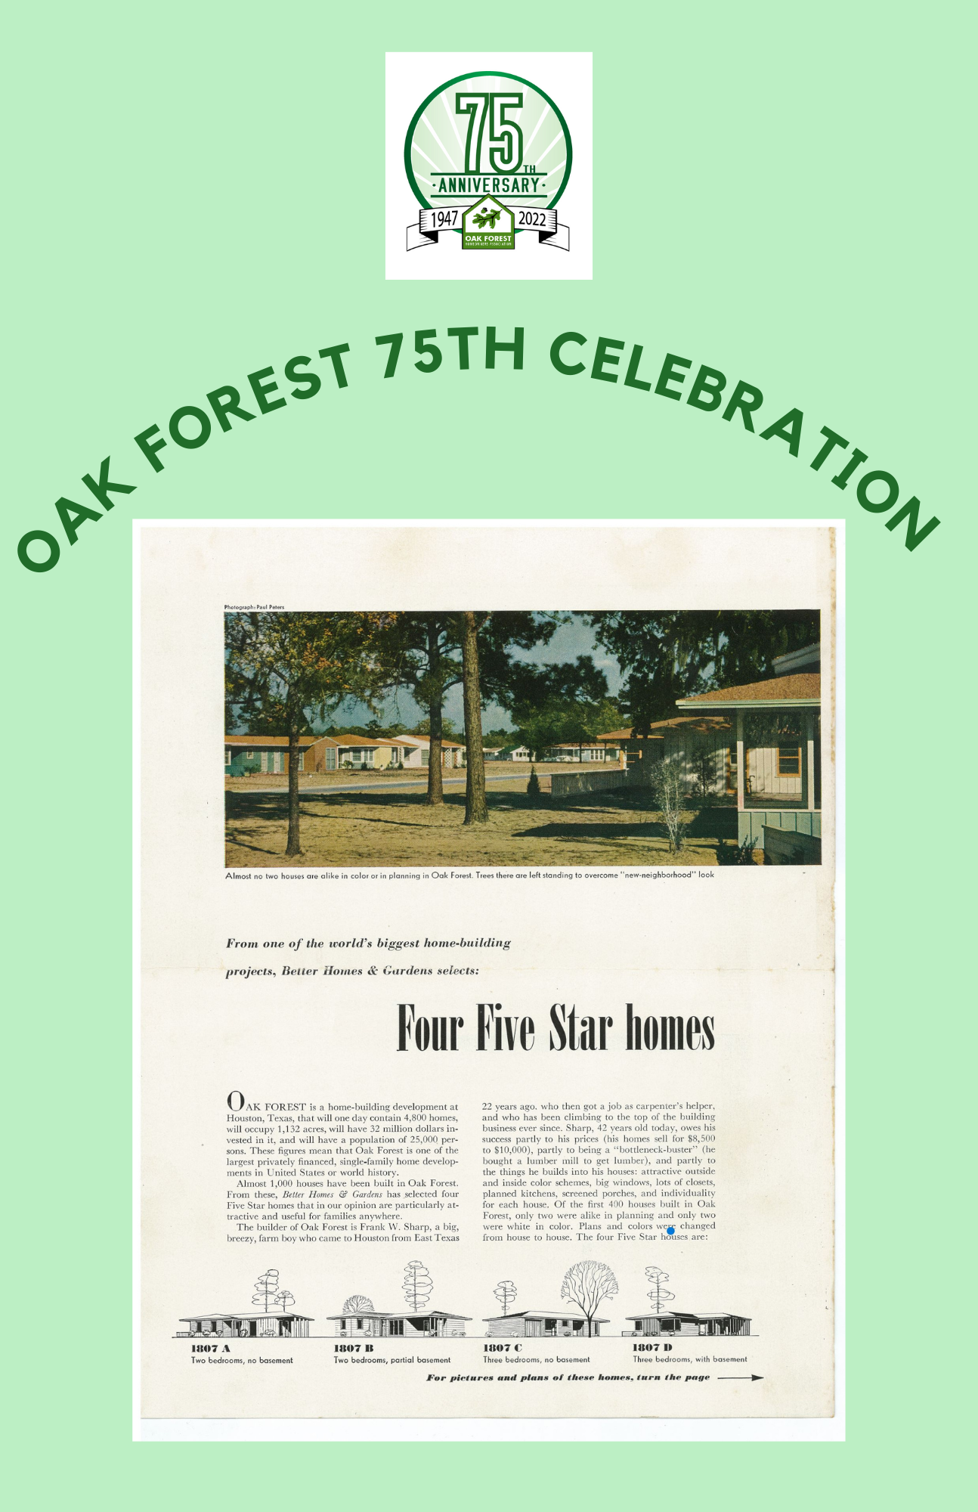

Slide 4
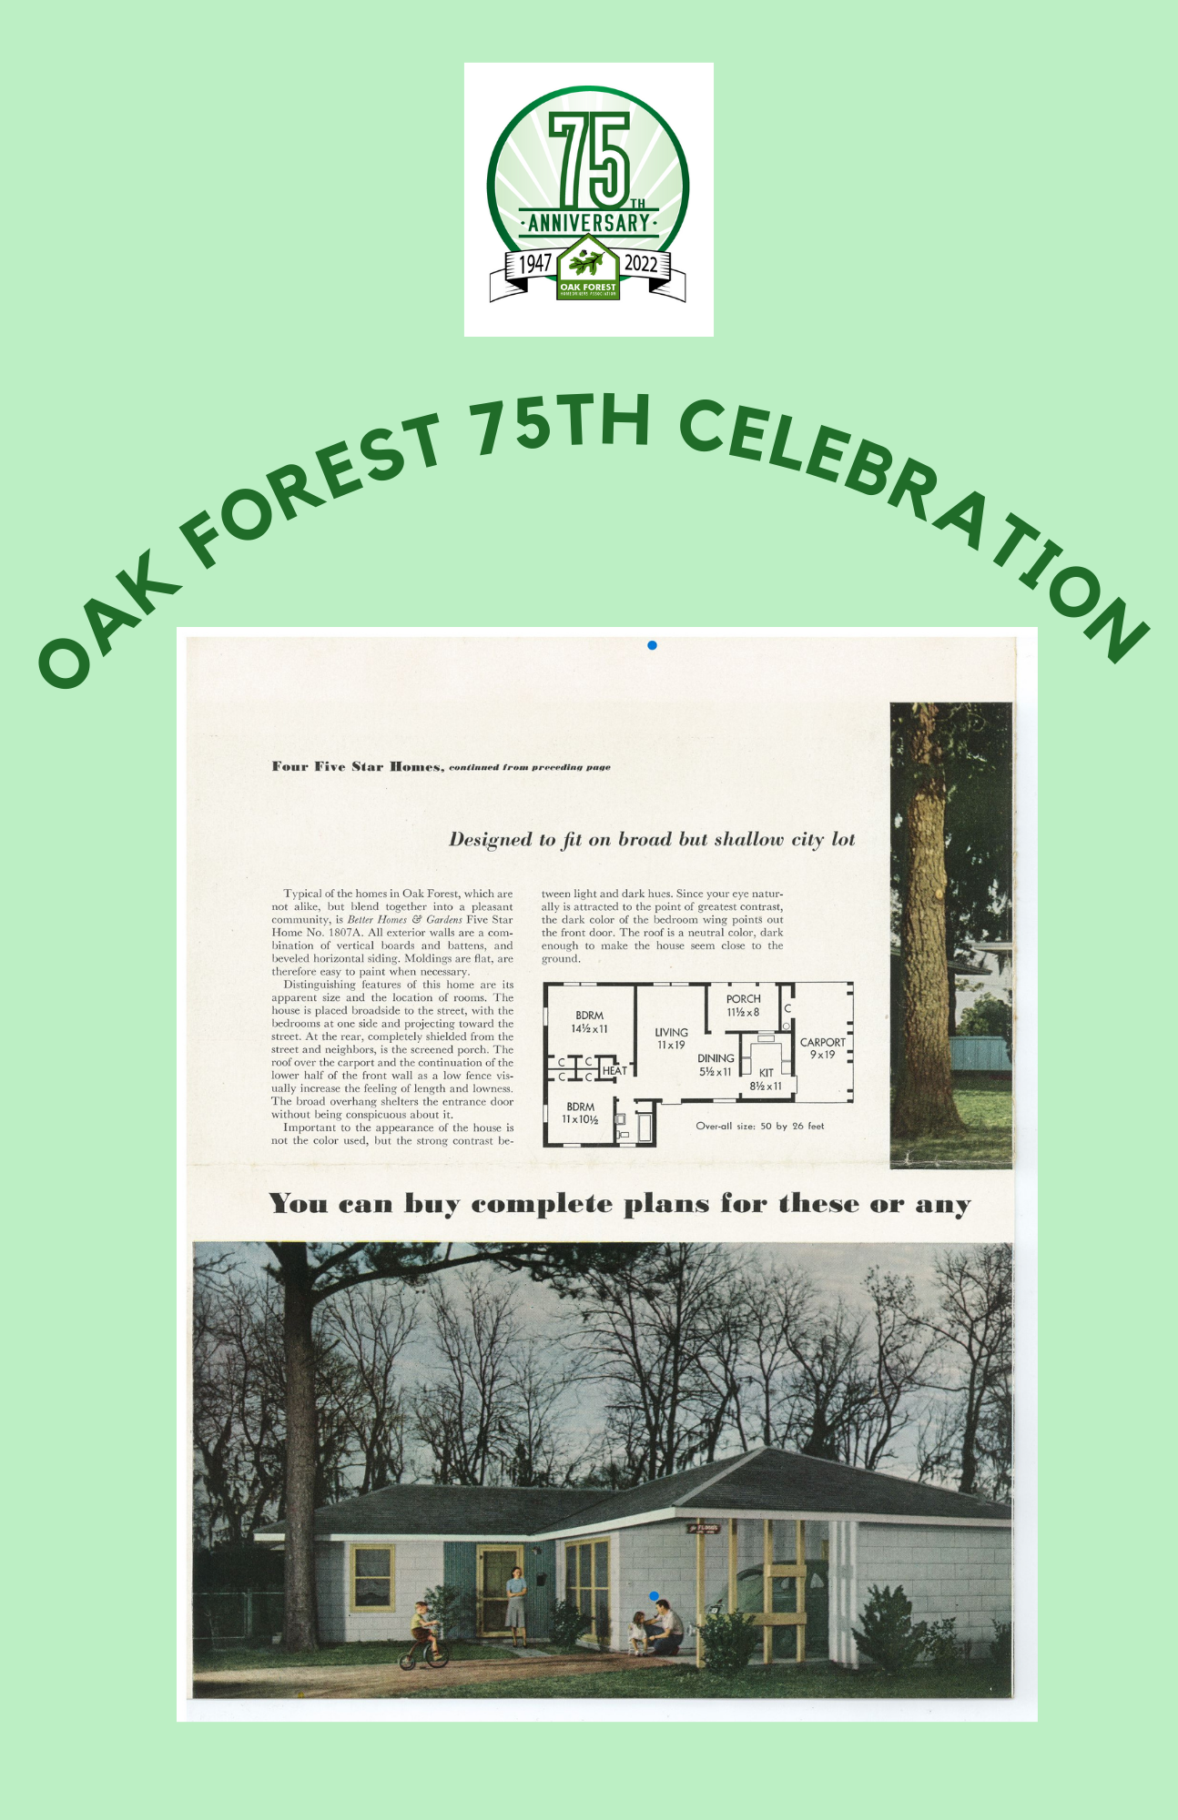

Slide 5
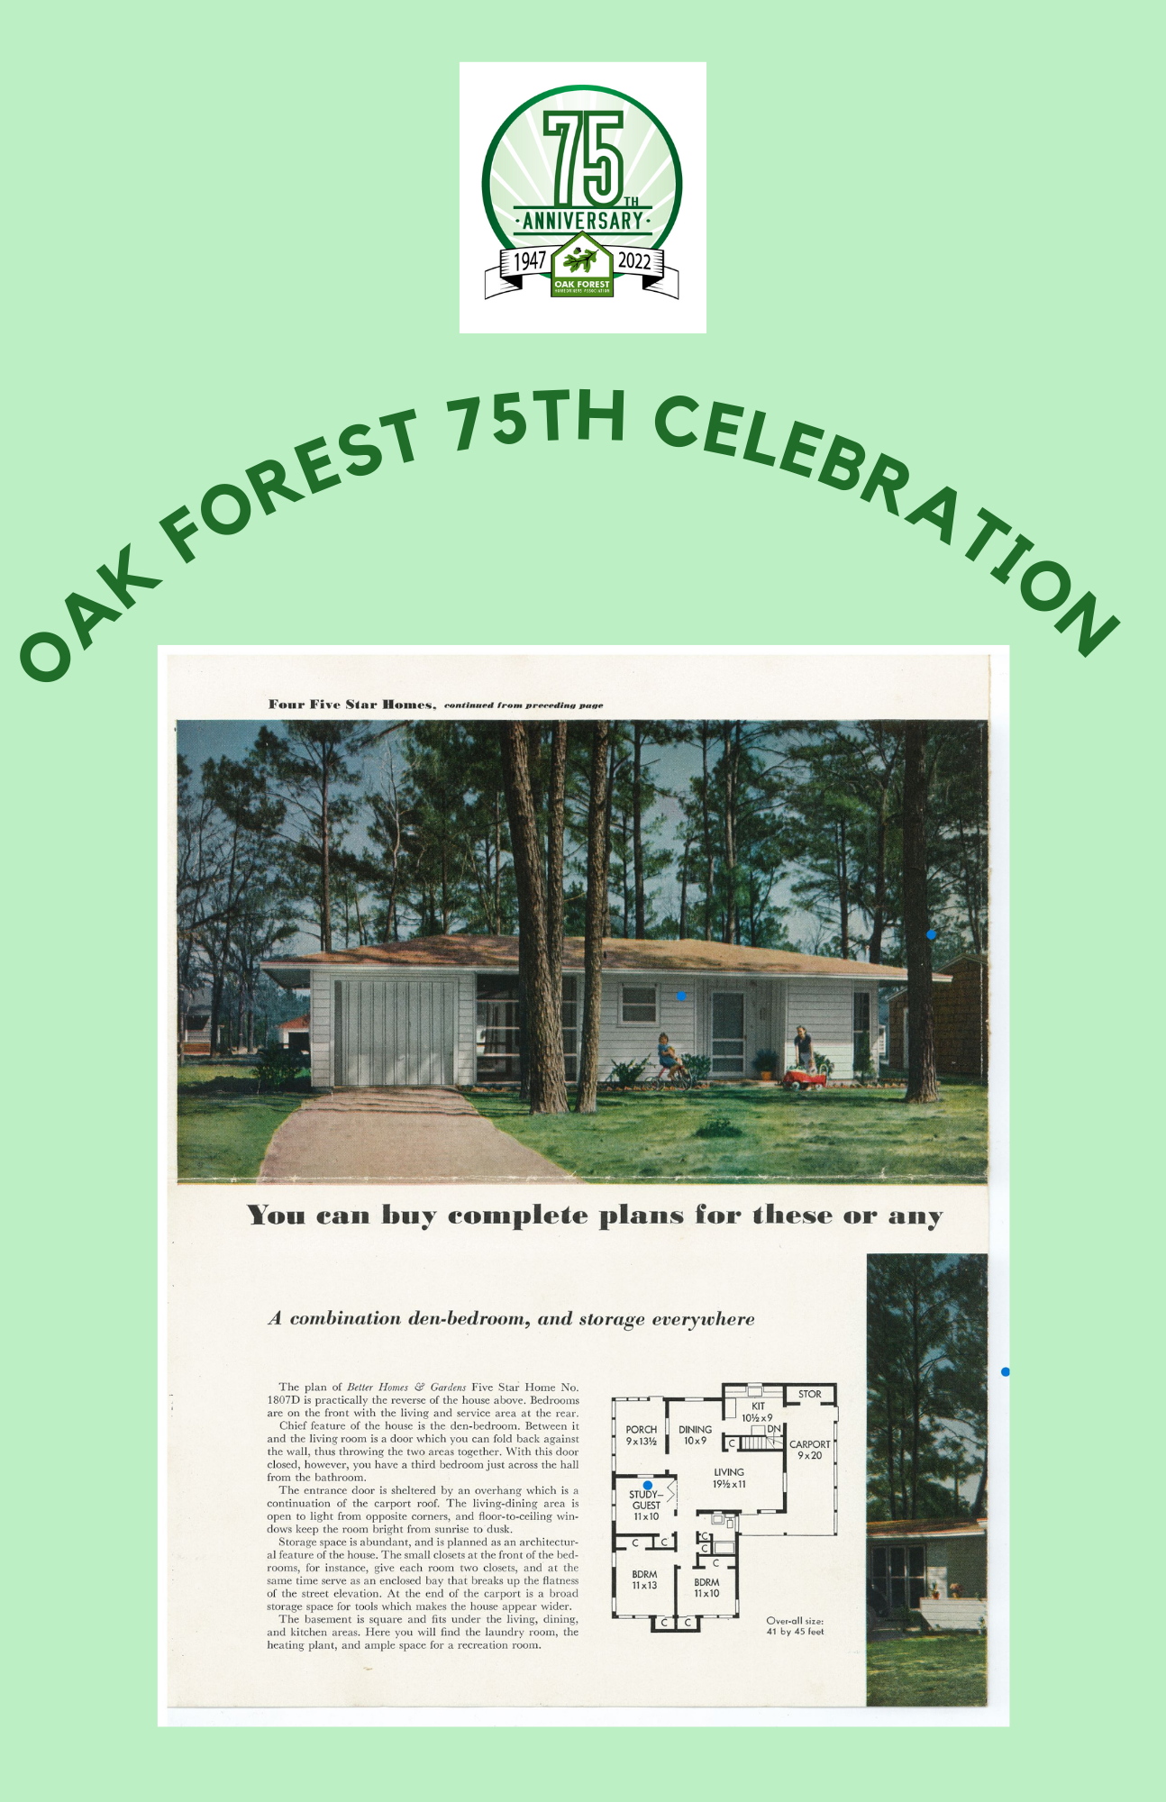

Slide 6
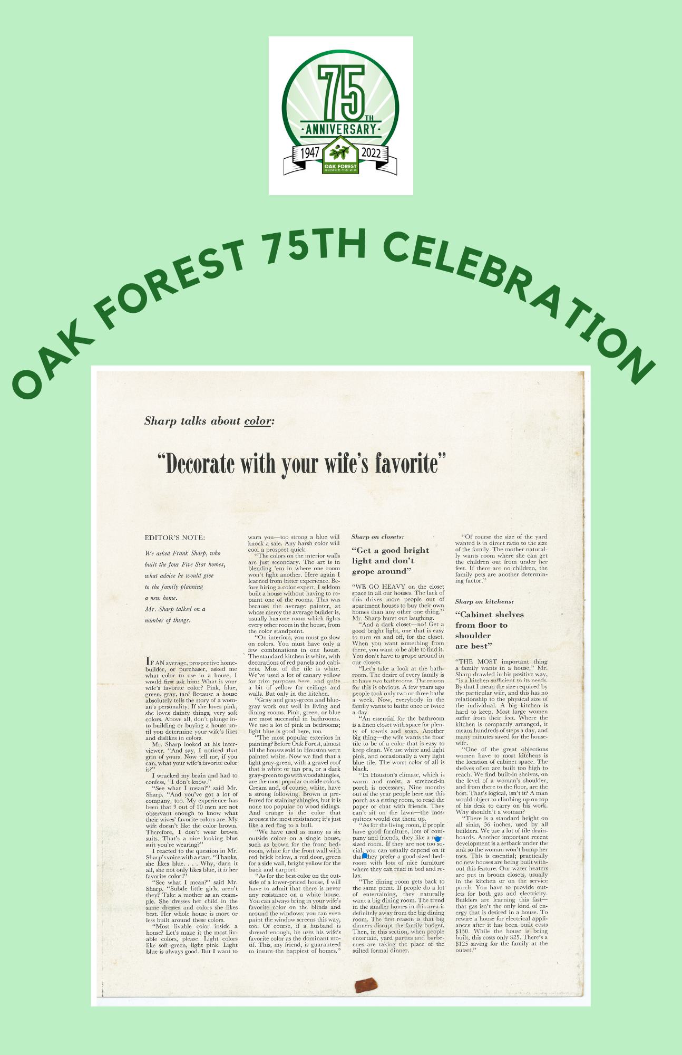

Slide 7
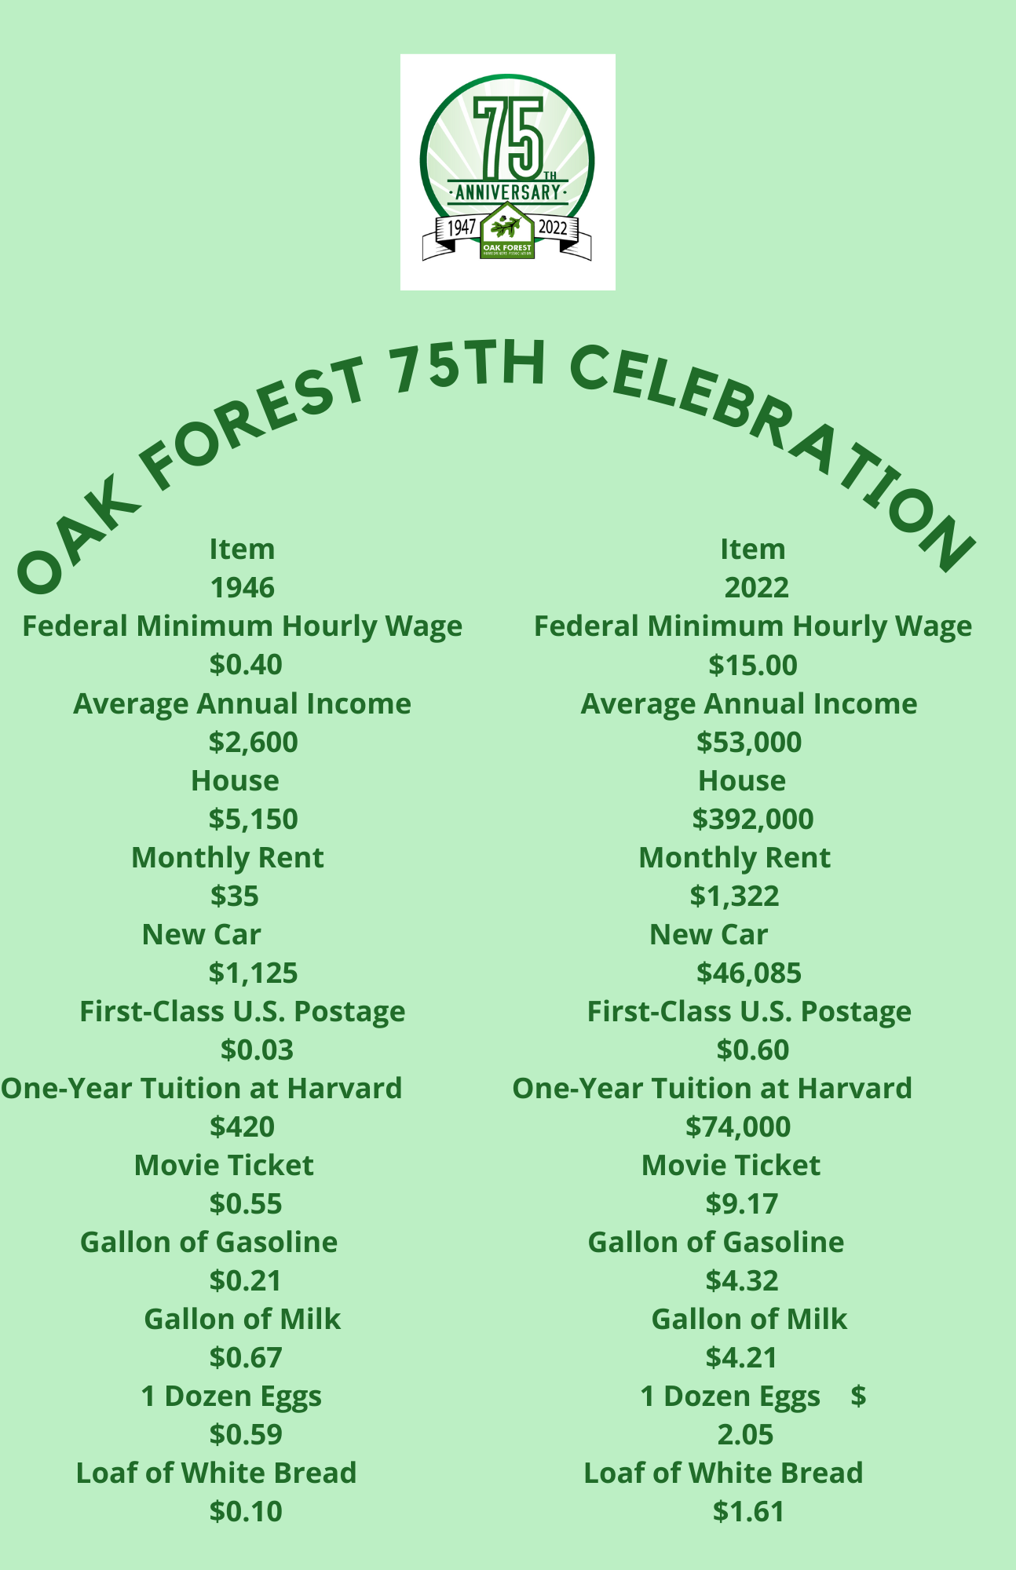

Slide 8
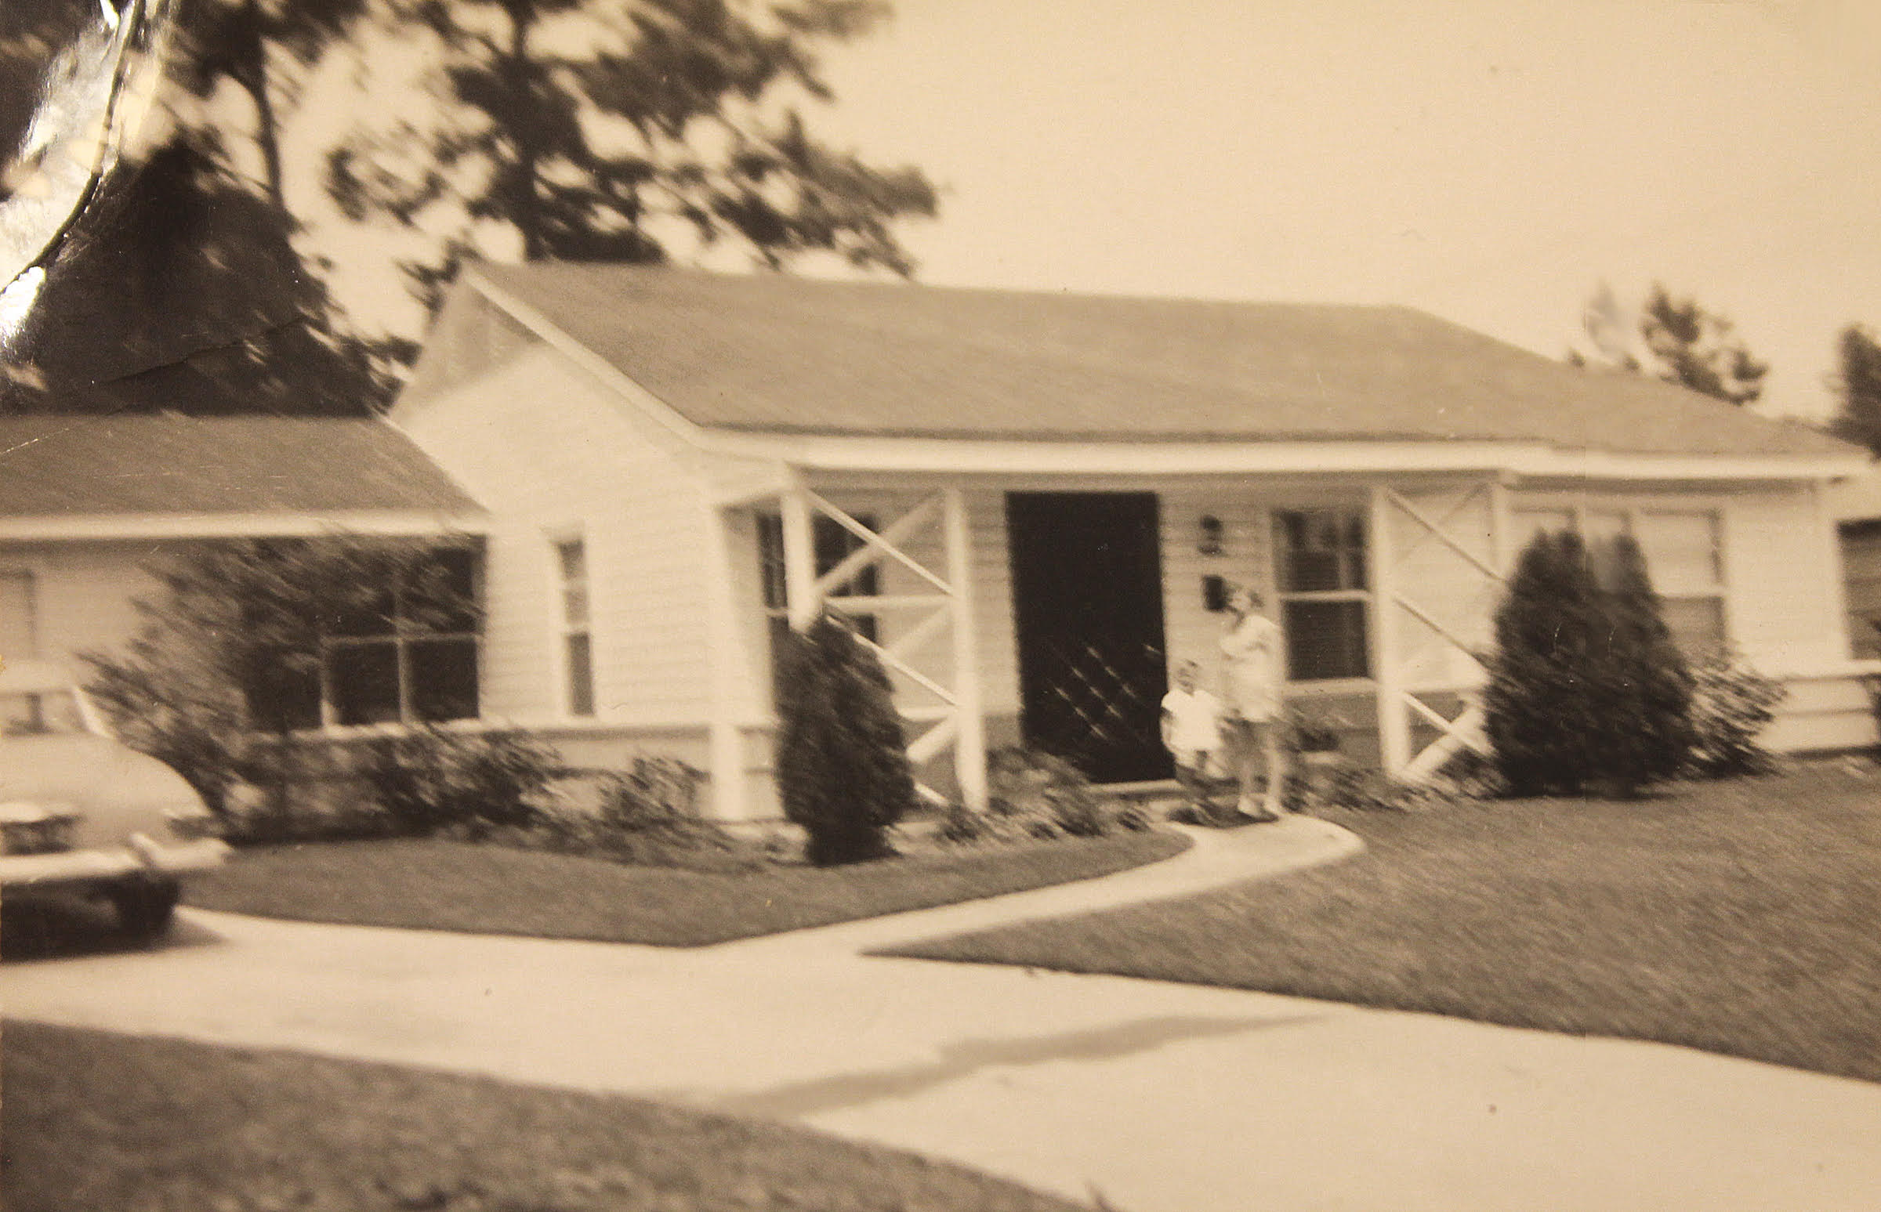
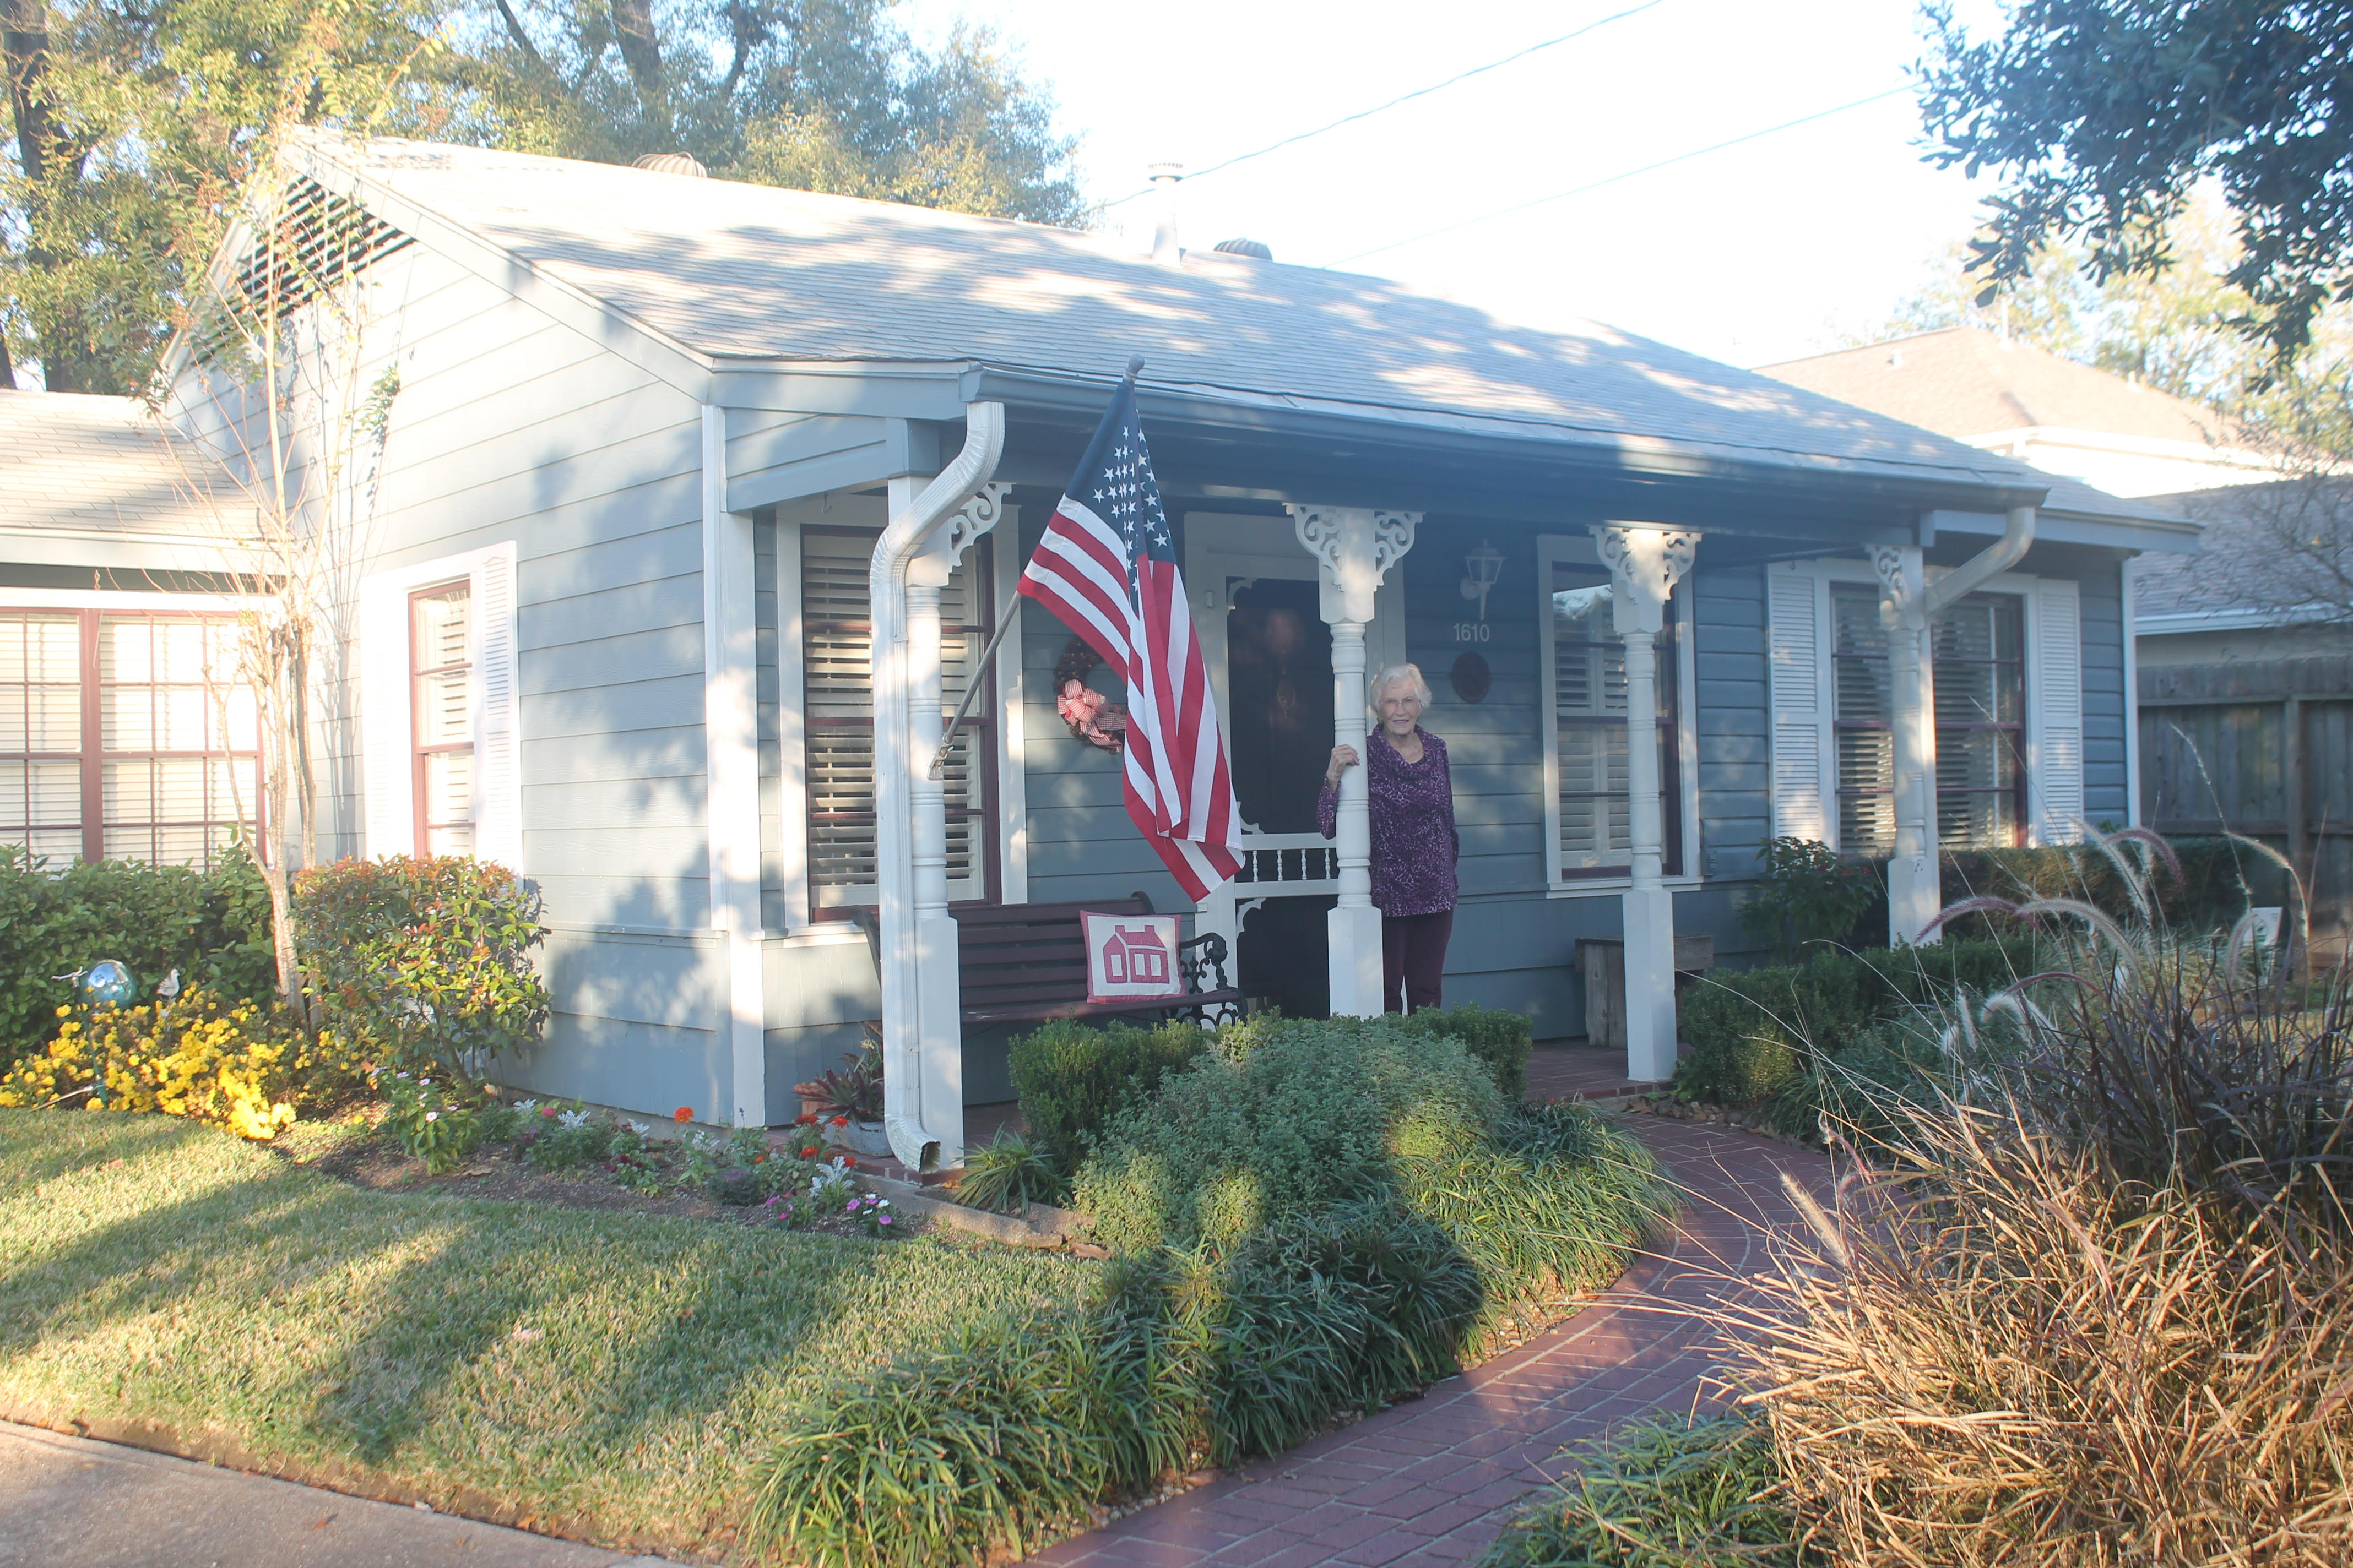
Oak Forest resident, Dorothy Pickens, in front of her home in 1950 and again in 2019

Slide 9
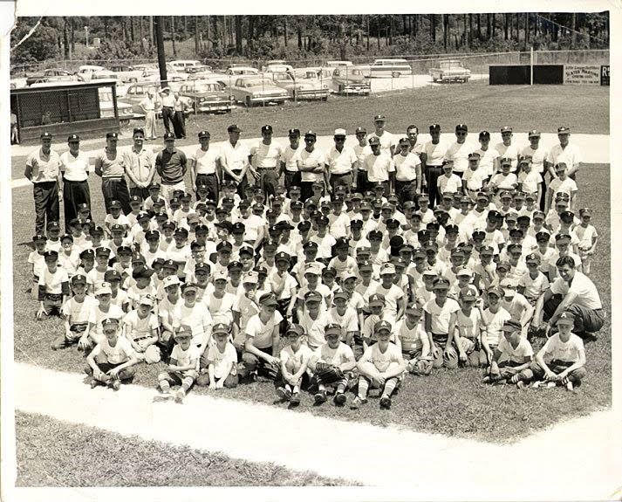
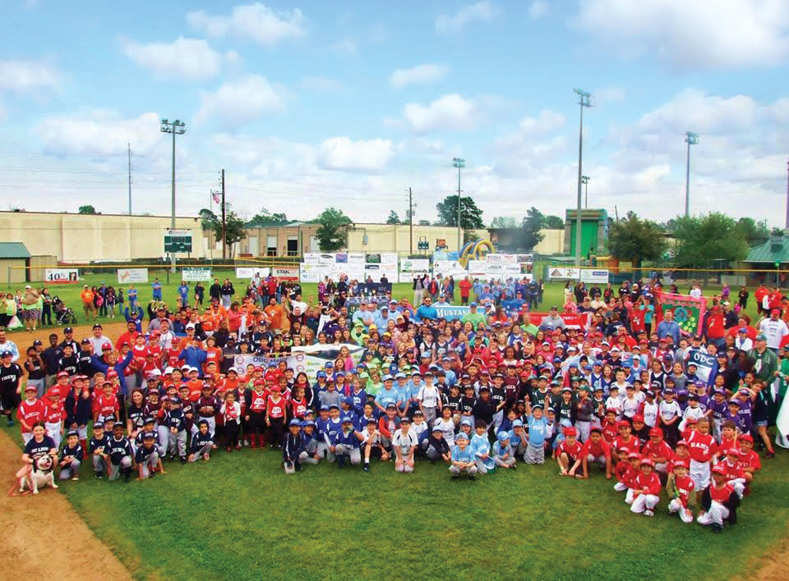
Oaks Dads' Club Opening Day Photos
(Years Unknown)

Slide 10
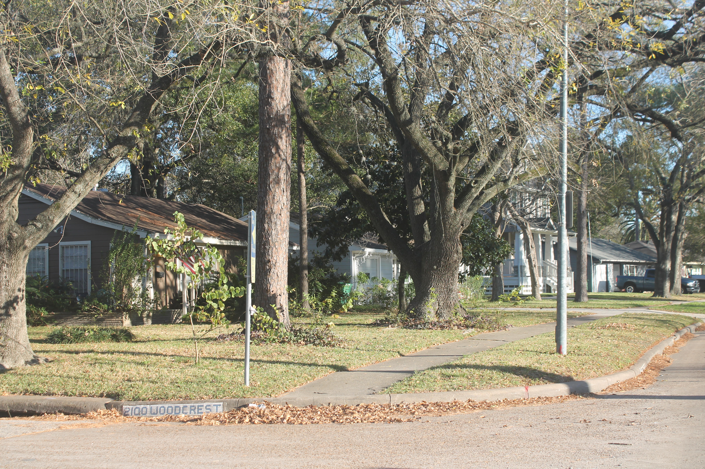
Same Vantage point
on East T.C. Jester, looking down Woodcrest,
from 1957 and again in 2019

Slide 11
The neighborhood paper, THE LEADER, was started by Al Cherry and Jack Worden in 1954. They sold the company in 1957 to Lee Burge. In 1969 due to his death, his son, Terry Burge, became the new publisher until he sold it to its current owner, Jonathan McElvy! Wonderful to have a neighborhood newspaper that makes Oak Forest an enjoyable community!

Slide 12
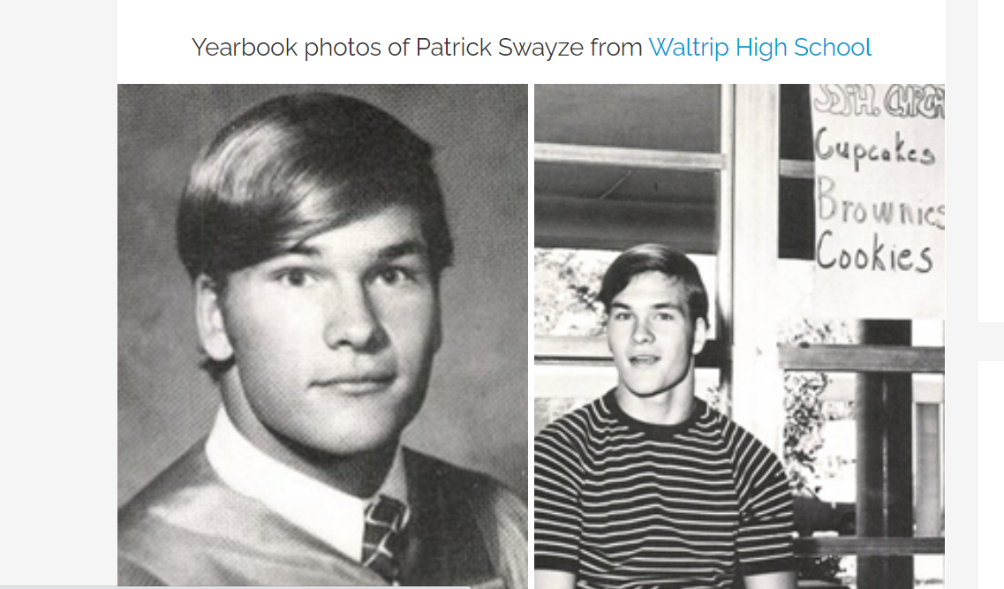
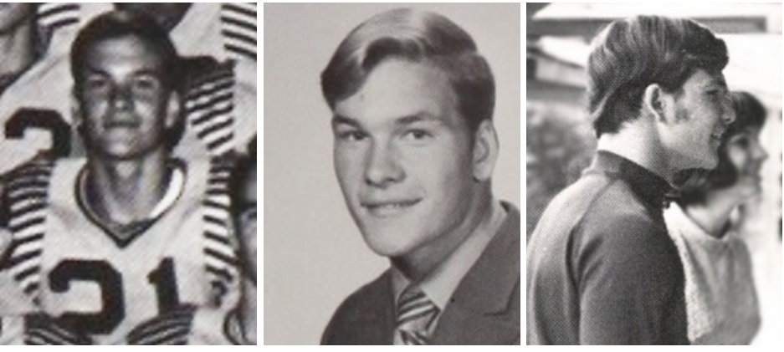
Well Known Neighbors:
Patrick Wayne Swayze
August 18, 1952 – September 14, 2009) was an actor, dancer, and singer-songwriter. He graduated from Waltrip High School, in Houston, TX, in 1971 (where his yearbook lists him as “Buddy Swayze”). While at Waltrip, he participated in football and drama. Also a classically-trained ballet dancer, Swayze started out his post-school career performing with Disney on Parade. His first major acting role was in the film The Outsiders, in 1983, and his big breakthrough came when he starred in Dirty Dancing in 1987. That film brought fame in more than one way; the soundtrack includes “She’s Like the Wind,” a power ballad sung by Swayze that became a top-10 hit. Lead roles in Road House and Ghost further cemented his popularity. In 1991, the same year that he co-starred in Point Break, Swayze was named People magazine’s “Sexiest Man Alive.” In 1997, he received a star on the Hollywood Walk of Fame. Swayze continued to act until his death from pancreatic cancer in 2009.

Slide 13
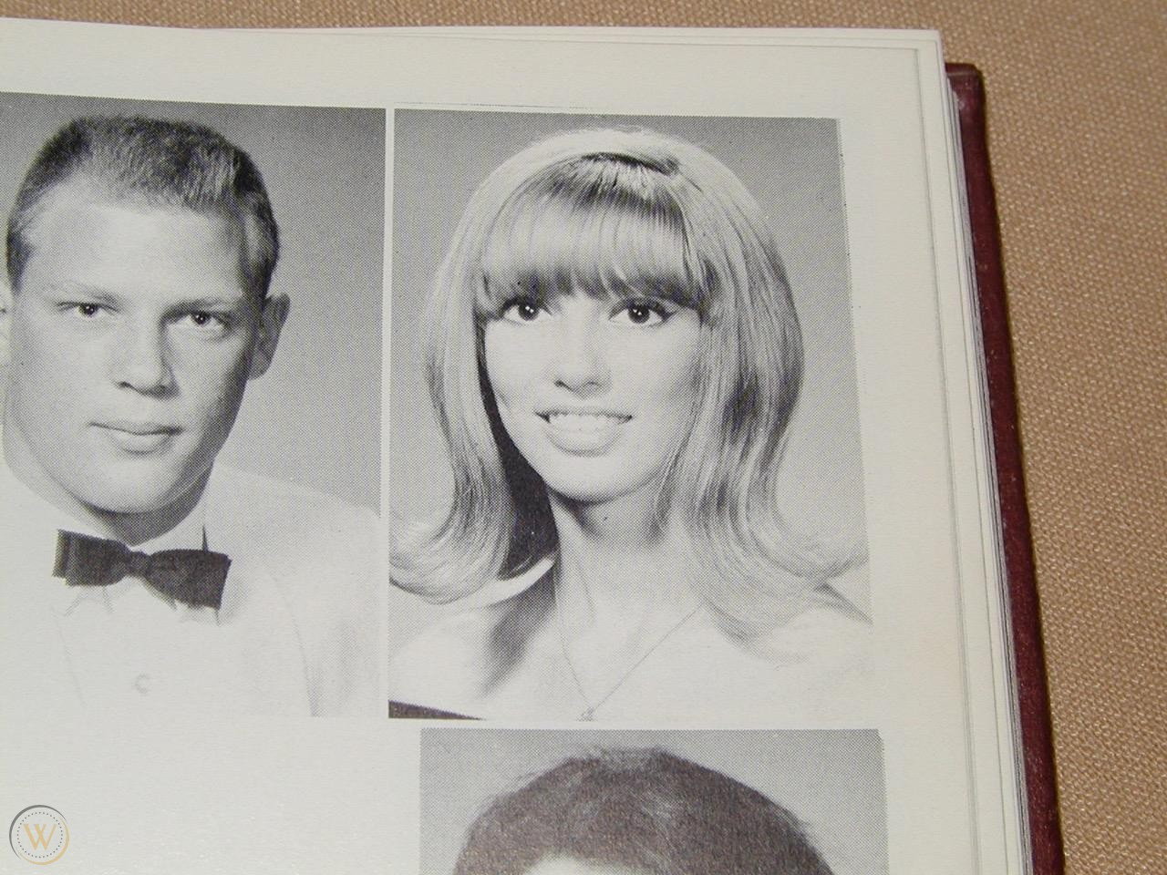
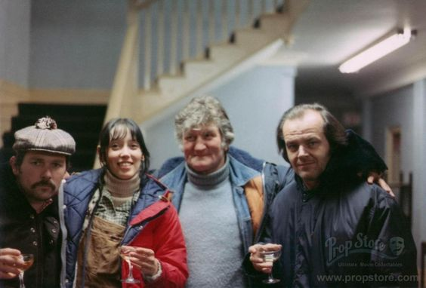
Well Known Neighbors: Shelley Duvall
She is a 1967 Graduate of Waltrip High School.
Duvall's film career began when Robert Altman discovered her in Houston while filming Brewster McCloud in 1970. He gave her a small part in the film. Duvall was given larger roles in later Altman films including McCabe and Mrs. Miller, Thieves Like Us, Nashville, 3 Women, and Popeye.
Since Popeye, Duvall has only appeared in a few films. She has produced high-quality children's programming for cable TV and home video. She has won numerous awards as the producer of "Faerie Tale Theatre," "Shelley Duvall's Tall Tales," and "Shelley Duvall's Bedtime Stories."

Slide 14
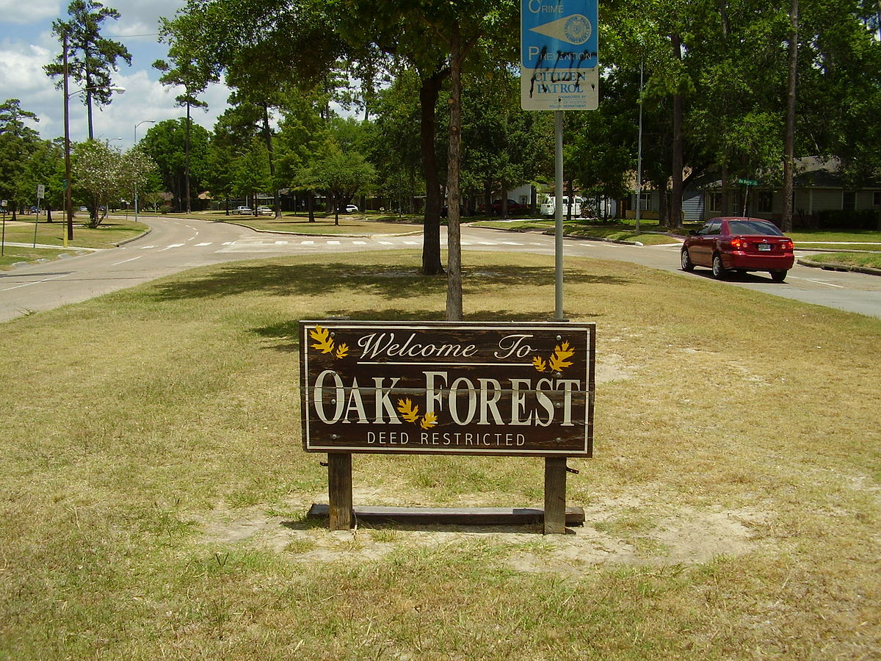
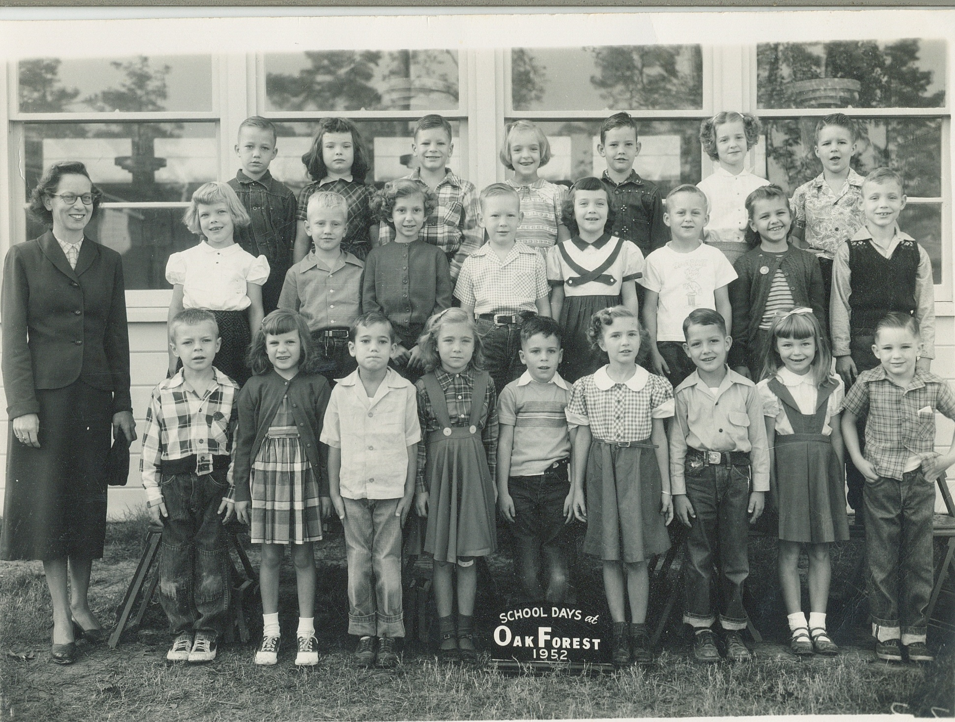
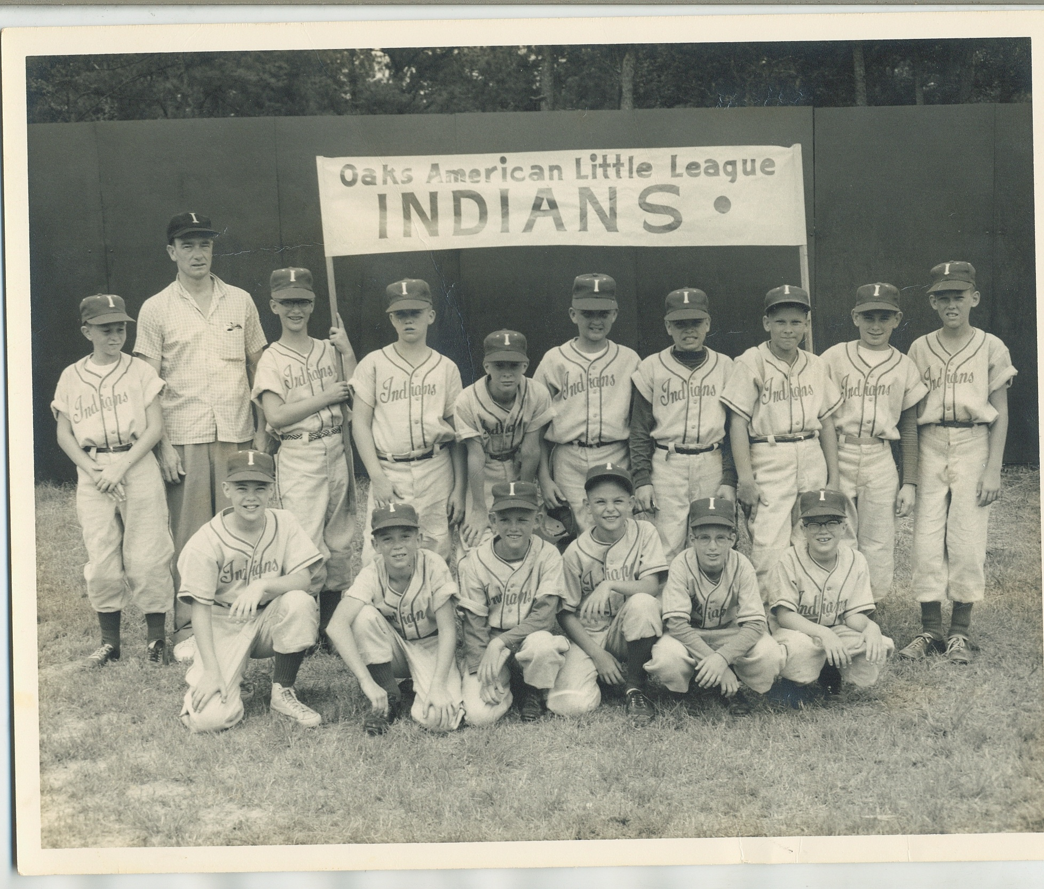
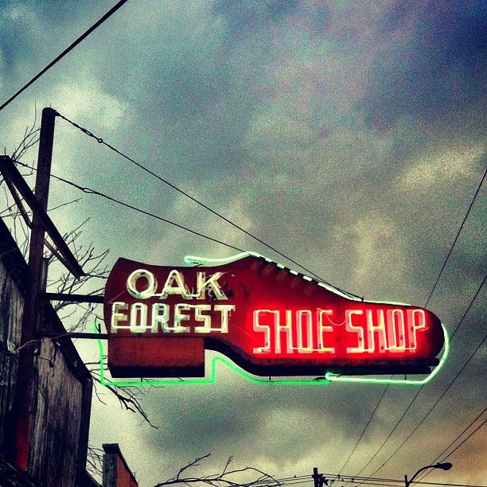
Photos to Enjoy!

Slide 15
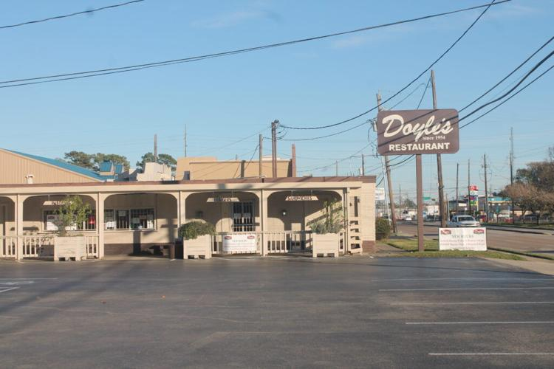
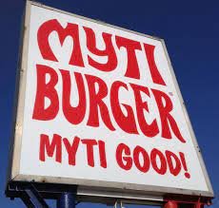
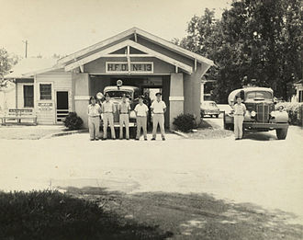
Photos to Enjoy!

Slide 16
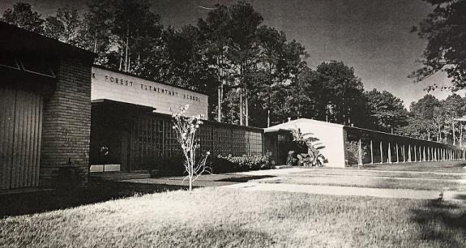
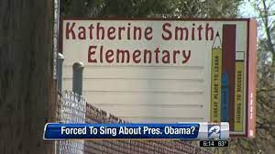
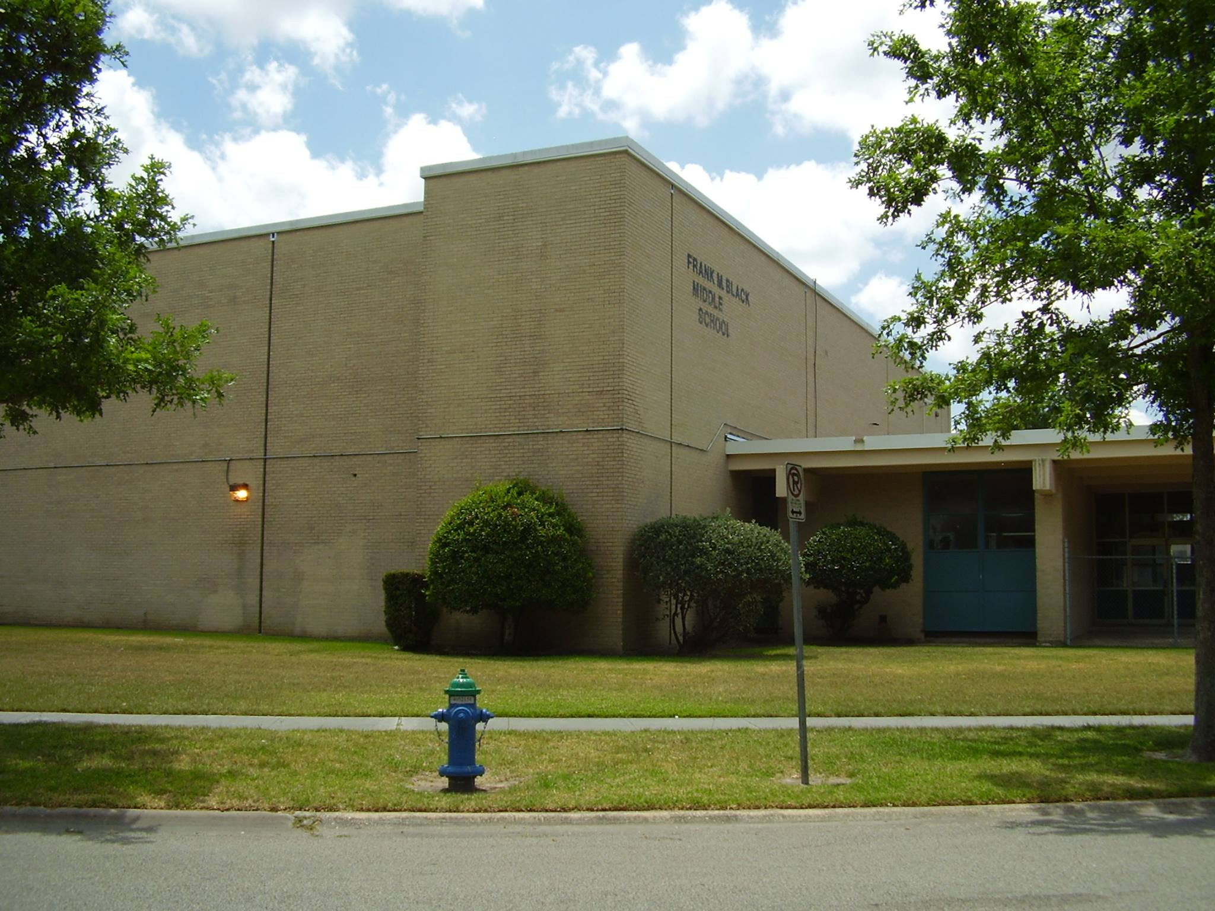
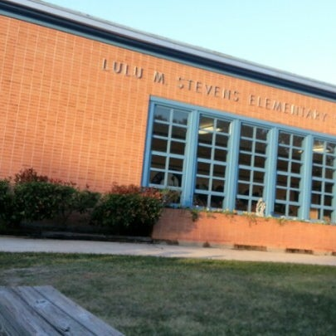
Photos to Enjoy!

Slide 17
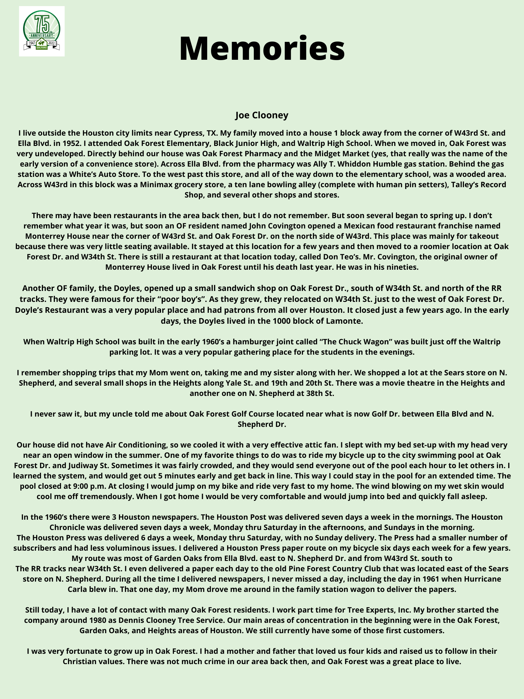

Slide 18
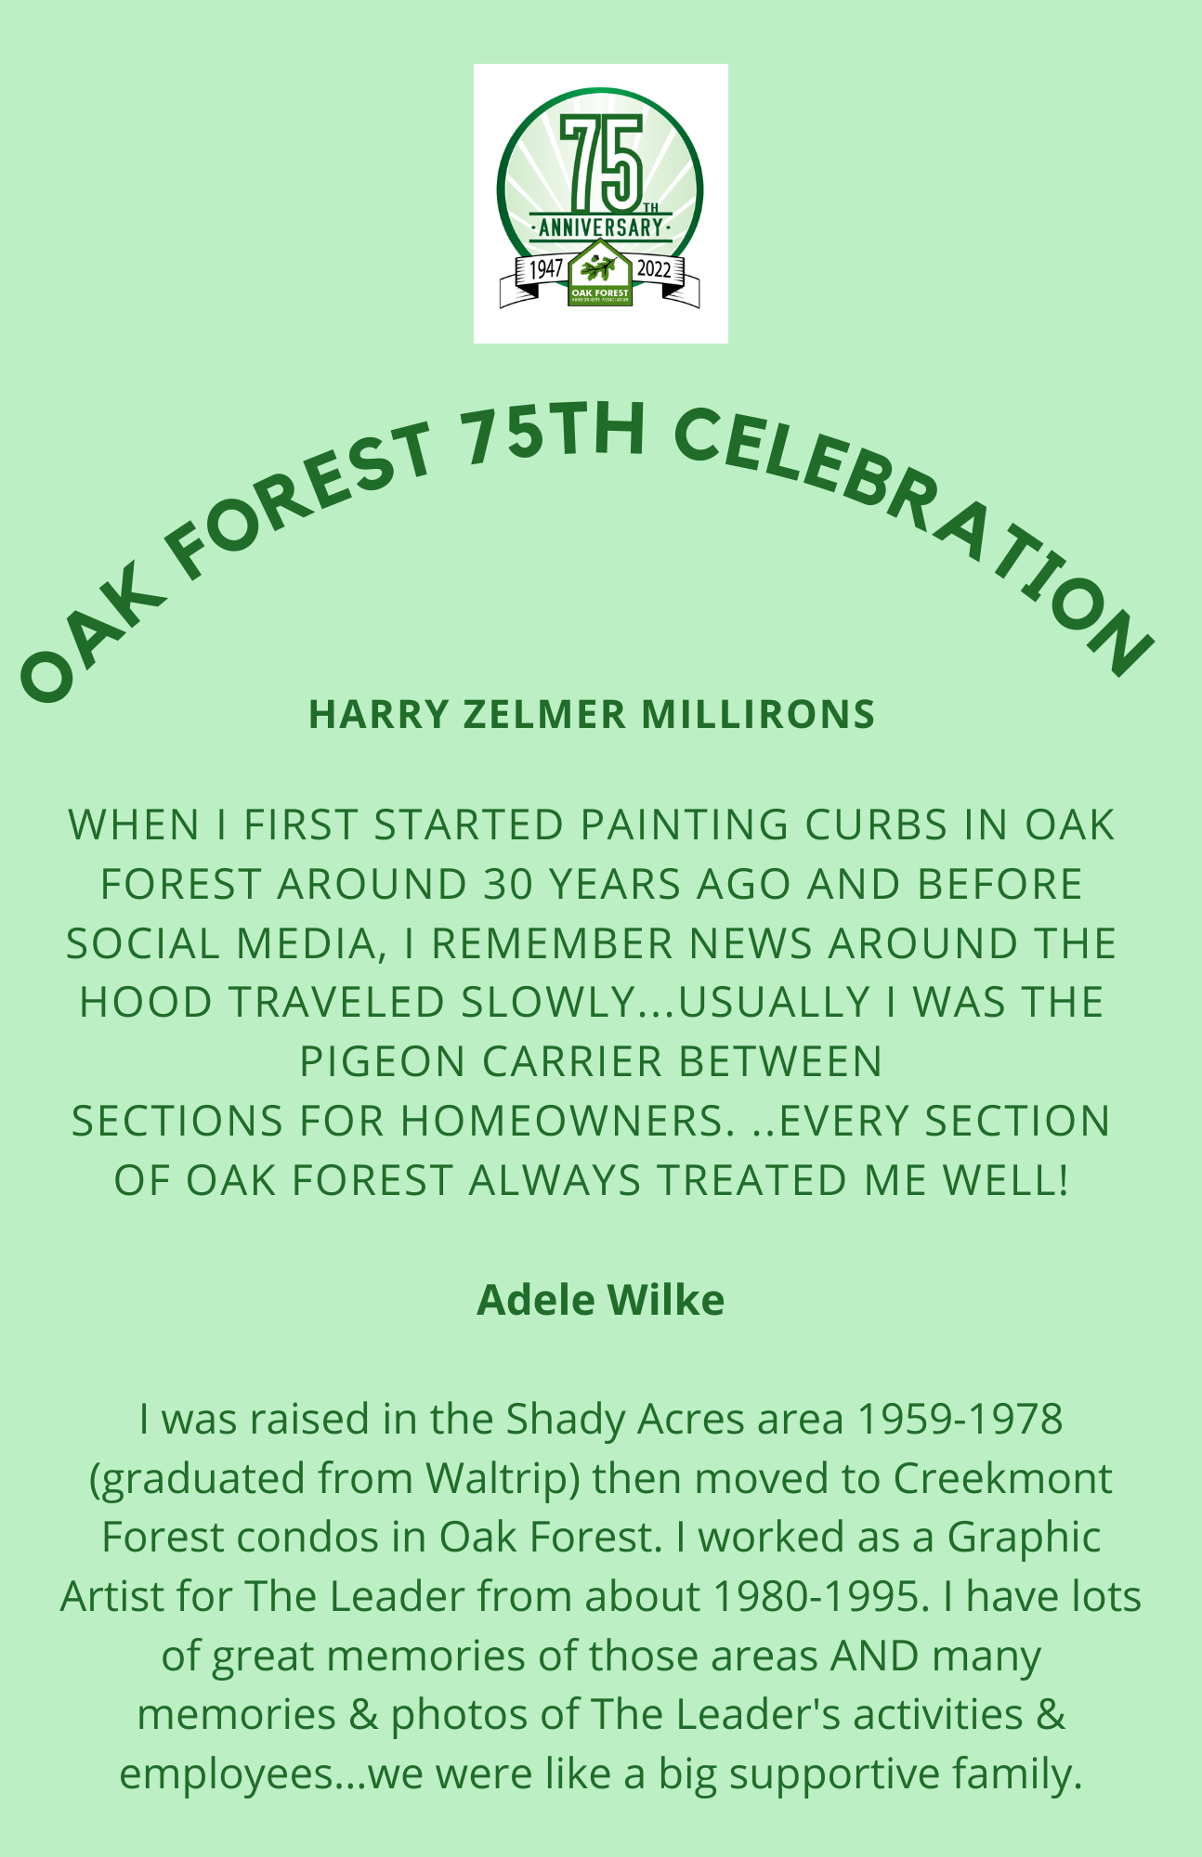
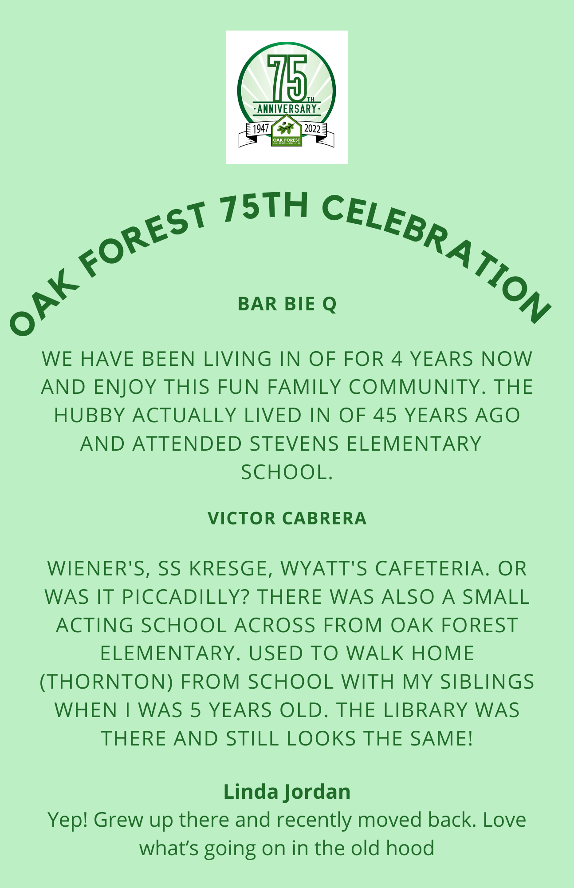

Slide 19
